Slide 1

Project Aim
Working on a security system that helps detect harmful activities on a Windows computer.

Slide 2
Dataset Used: ADFA-WD
Australian Defense Force Academy –Windows Dataset is a Windows-based dataset created for intrusion detection
What does the dataset contain?
Normal system activity
Different types of attacks

Slide 3
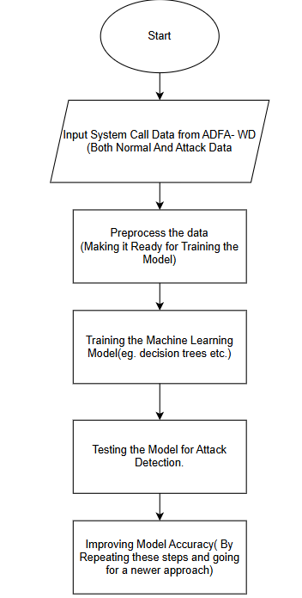
Flowchart for Intrusion Detection Using ADFA-WD

Slide 4
Challenges Found:
Too much data
Hard to detect new attacks
False alarms

